Slide 1



Group C

Slide 2
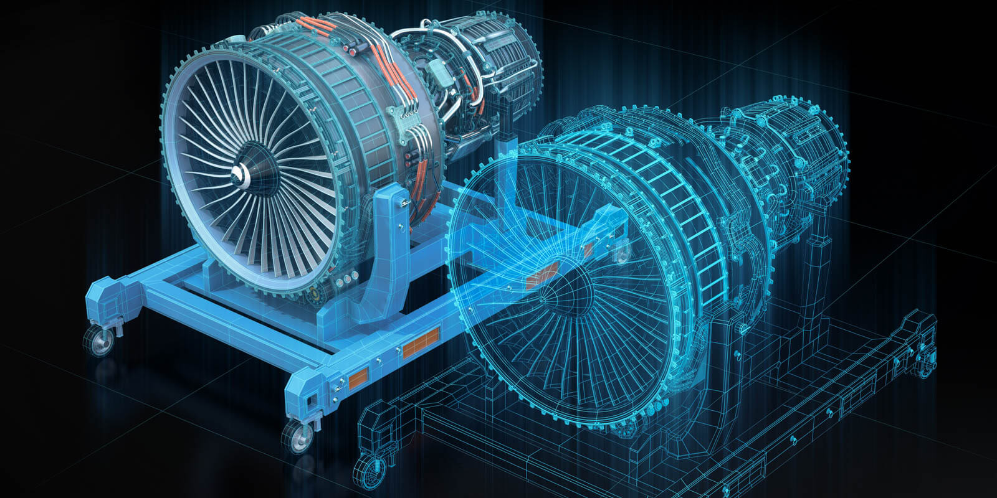
Introduction – Digital Twin
Digital Twin, defined as “a digital representation of a physical product, incorporates product specifications, geometry models, material properties, and associated simulation information.”
A simpler definition is that, Digital Twin is a digital copy of a physical asset or process that lives and evolves over its lifetime.
Digital Twin can also be considered as the virtual replica of an asset and/or the mathematical models that describe its operation.
Notes:
Go into breakout rooms to discuss this

Slide 3
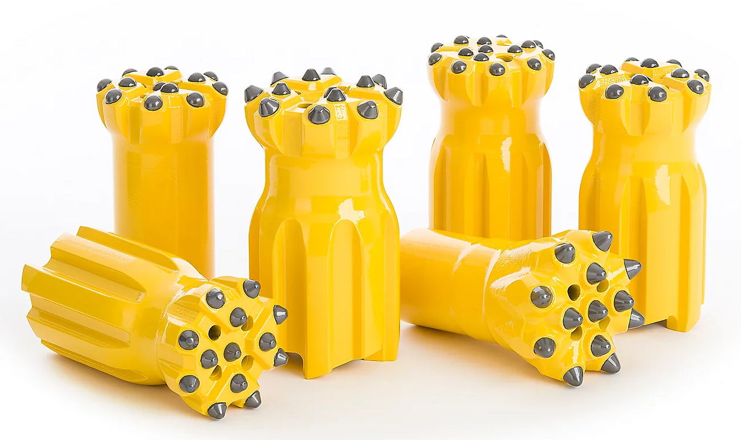
Problem Statement
The project involved the development of a digital twin of a drill bit, to represent the capability of an integrated digital solution.
Through utilization of a digital twin, an organization has a potential to optimize production by varying the conditions the drill bit is subjected to on the digital twin and studying the effects on the ROP as well as pushing the drilling parameters without leading to premature failure of the drill bit.
A successful drilling operation depends on factors such as:
Increasing drilling speed/ rate of penetration,
Lower operational costs,
Maintaining safe working conditions.
With drilling making up most of the exploration projects costs, increasing the efficiency of drilling is imperative to upscale production.
Additional costs may be brought about by delays such as: Stuck pile and drilling bit failures
A major factor that contributes to increased operational costs is delays in the operation owing to a failed drill bit.
Notes:
Go into breakout rooms to discuss this

Slide 4
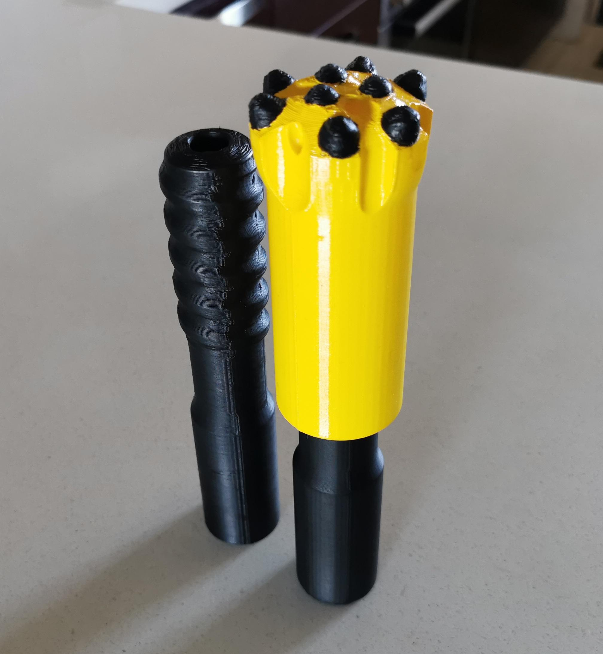
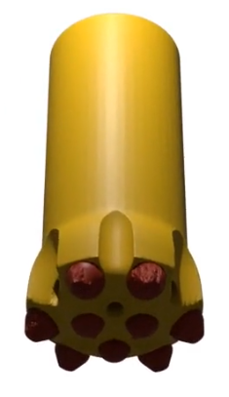
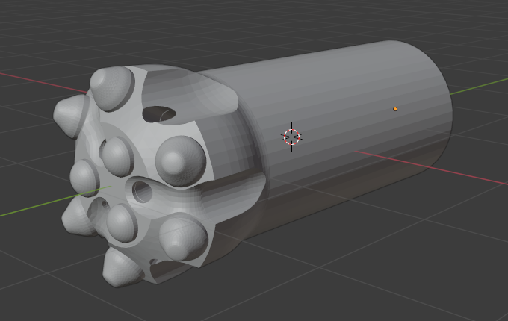
Objectives
Find a relevant dataset that will be used to model the physical asset
To train a machine learning model using the data
To create a digital twin with regards to a Top hammer drill bit that can take inputs
Build a dashboard to represent our digital twin
To develop a digital thread that allows for communication between the physical asset and the digital asset to demonstrate operation under different conditions
To develop a 3D model of a Top hammer drill bit
Notes:
Go into breakout rooms to discuss this

Slide 5
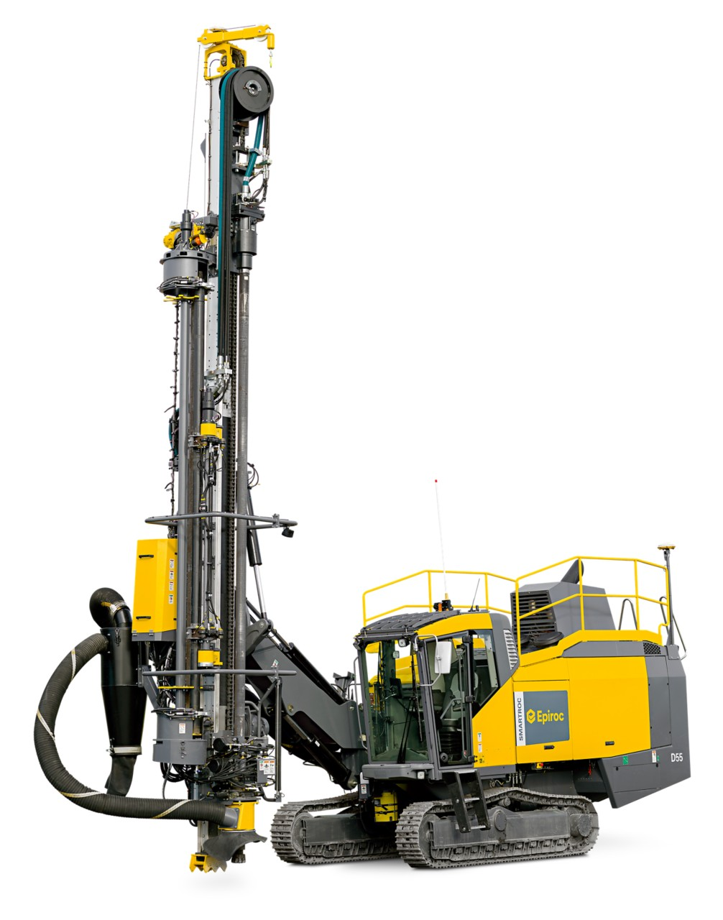
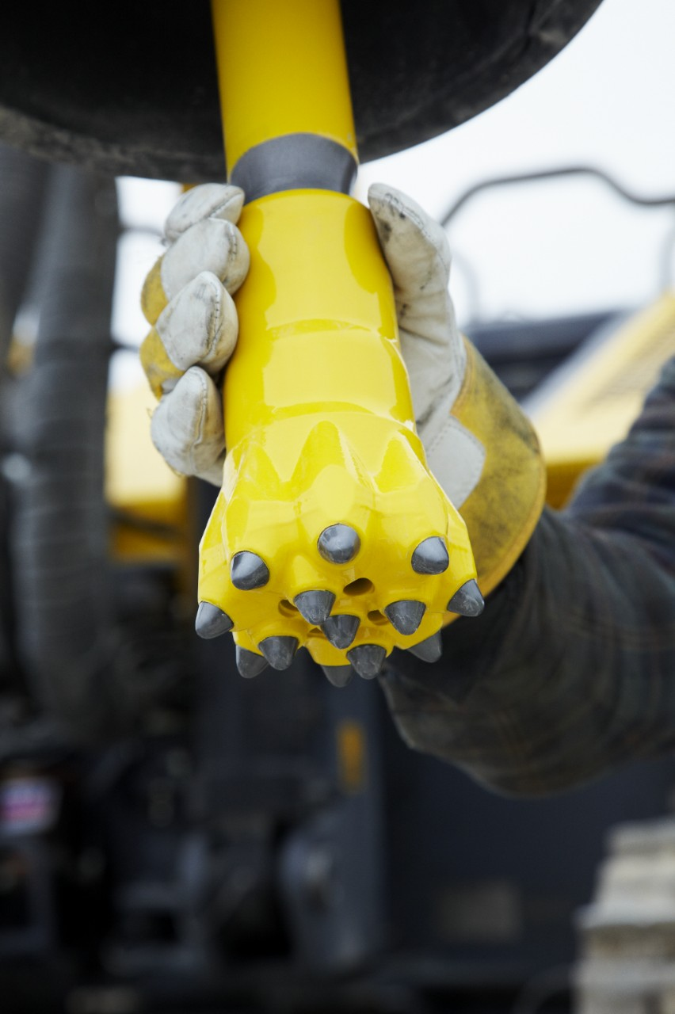
Introduction – The Asset
Selected asset
Button drill bit used for mining and construction
What is a button drill bit?
A button drill bit is one of the bit types which actually cuts into the rock when drilling.
Located at the tip of the drillstring.
A rotating apparatus that usually consists of two or three cones made up of the hardest of materials (usually steel, tungsten carbide, and/or synthetic or natural diamonds) and sharp teeth that cut into the rock and sediment below.
The type of drill bit selected is dependant on a number of factors such as the nature of the drilling operation and the nature of the rock.
Notes:
Go into breakout rooms to discuss this

Slide 6

Business Case
Drilling efficiency is a determined by a number of critical operational parameters:
These parameters, referred to as performance qualifiers include footage drilled per BHA, downhole tool life, vibrations control, durability, steering efficiency, directional responsiveness, Rate Of Penetration, borehole quality, etc.
Drilling efficiency must be improved, in order to drive down operational costs.
Some of these parameters such as borehole quality are determined by static factors such as the type of rock and one of the easier parameters to analyze and optimize is the Rate of Penetration.
The maximization of ROP is often directly related to the minimization of drilling costs and, therefore, it is a significant measure of drilling performance
Notes:
Go into breakout rooms to discuss this

Slide 7
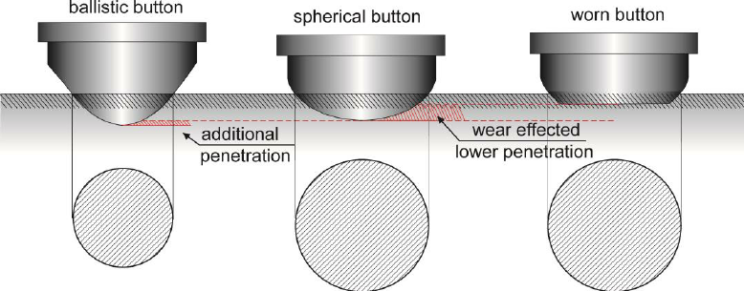
Rate of Penetration
In the drilling industry, the rate of penetration (ROP), also known as penetration rate or drill rate, is the speed at which a drill bit breaks the rock under it to deepen the borehole.
Normally measured in feet per minute or meters per hour, but sometimes it is expressed in minutes per foot.
Three critical Parameters affecting Rate of Penetration:
Rig/ Bit parameters, - Controllable
Mud related parameters - Controllable
Formation parameters - Uncontrollable
Maximization of ROP is directly related to the minimization of drilling costs and, therefore, it is a significant measure of drilling performance.
Hence a the target variable in our study.
Drill Bit Shapes
Notes:
Go into breakout rooms to discuss this

Slide 8
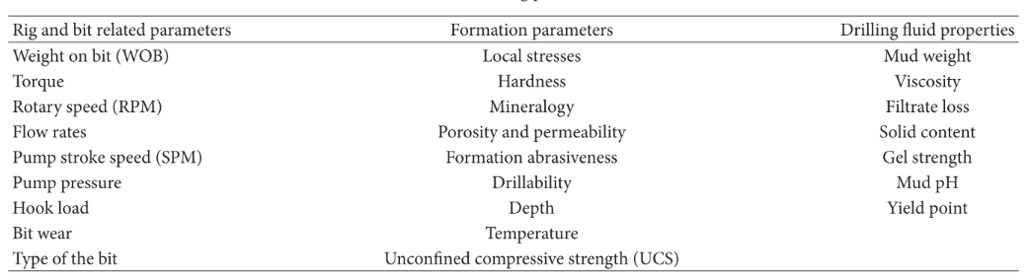
ROP related drilling parameters
Notes:
Go into breakout rooms to discuss this

Slide 9

Operation
Notes:
Go into breakout rooms to discuss this

Slide 10
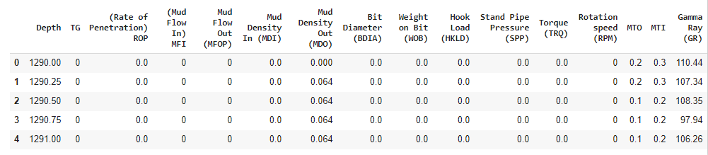
Physical Asset
The physical asset is modelled from from a drilling dataset obtained from surface data logging (SDL) tools.
The dataset represents data collected at surface and includes a number of parameters including the measured depth (D), hookload (HKLD), weight on bit (WOB), rotation speed (RPM), torque (TRQ), mud flow-in (MFI), temperature gradient (TG), mud flow-out (MFOP), Stand Pipe Pressure(SPP) etc.
The dataset after cleaning has 14549 rows, 15 independent variables and our target variable, the Rate of Penetration.
Notes:
Go into breakout rooms to discuss this

Slide 11
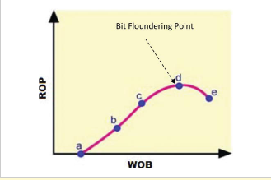
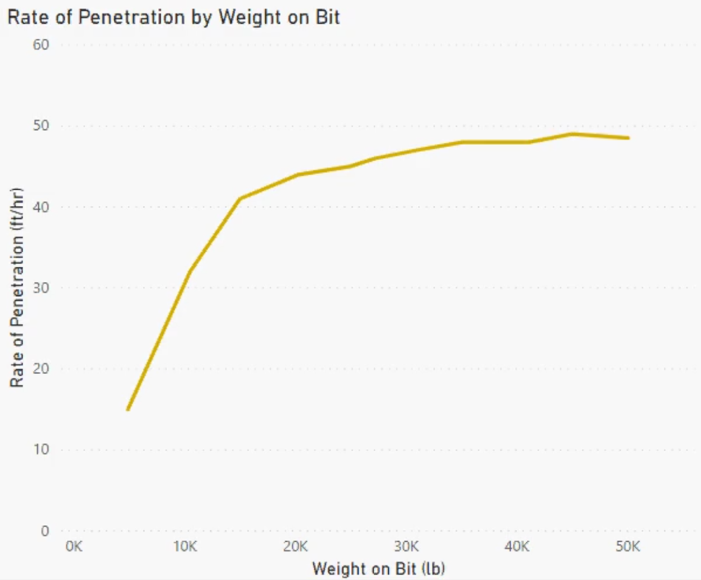
Asset Parameters
The Rate Of Penetration follows a complex relationship with the drilling parameters in our dataset such as weight on bit (WOB), torque (TRQ), mud flow-in (MFI), temperature gradient (TG) etc.
The literature surveyed supported the Weight on bit, Torque and Temperature gradient as important features for prediction and these are the variables used for our digital model. The relationship between the Rate of Penetration and Weight on bit is shown below.
* Weight on bit (WOB) represents the amount of axial force applied onto the bit which is then transferred to the formation causing it to break.
**Torque(TRQ) is the rotational force between the drill string and the formation
***Temperature Gradient(TG) rate of temperature change measured at a point
Notes:
Go into breakout rooms to discuss this

Slide 12
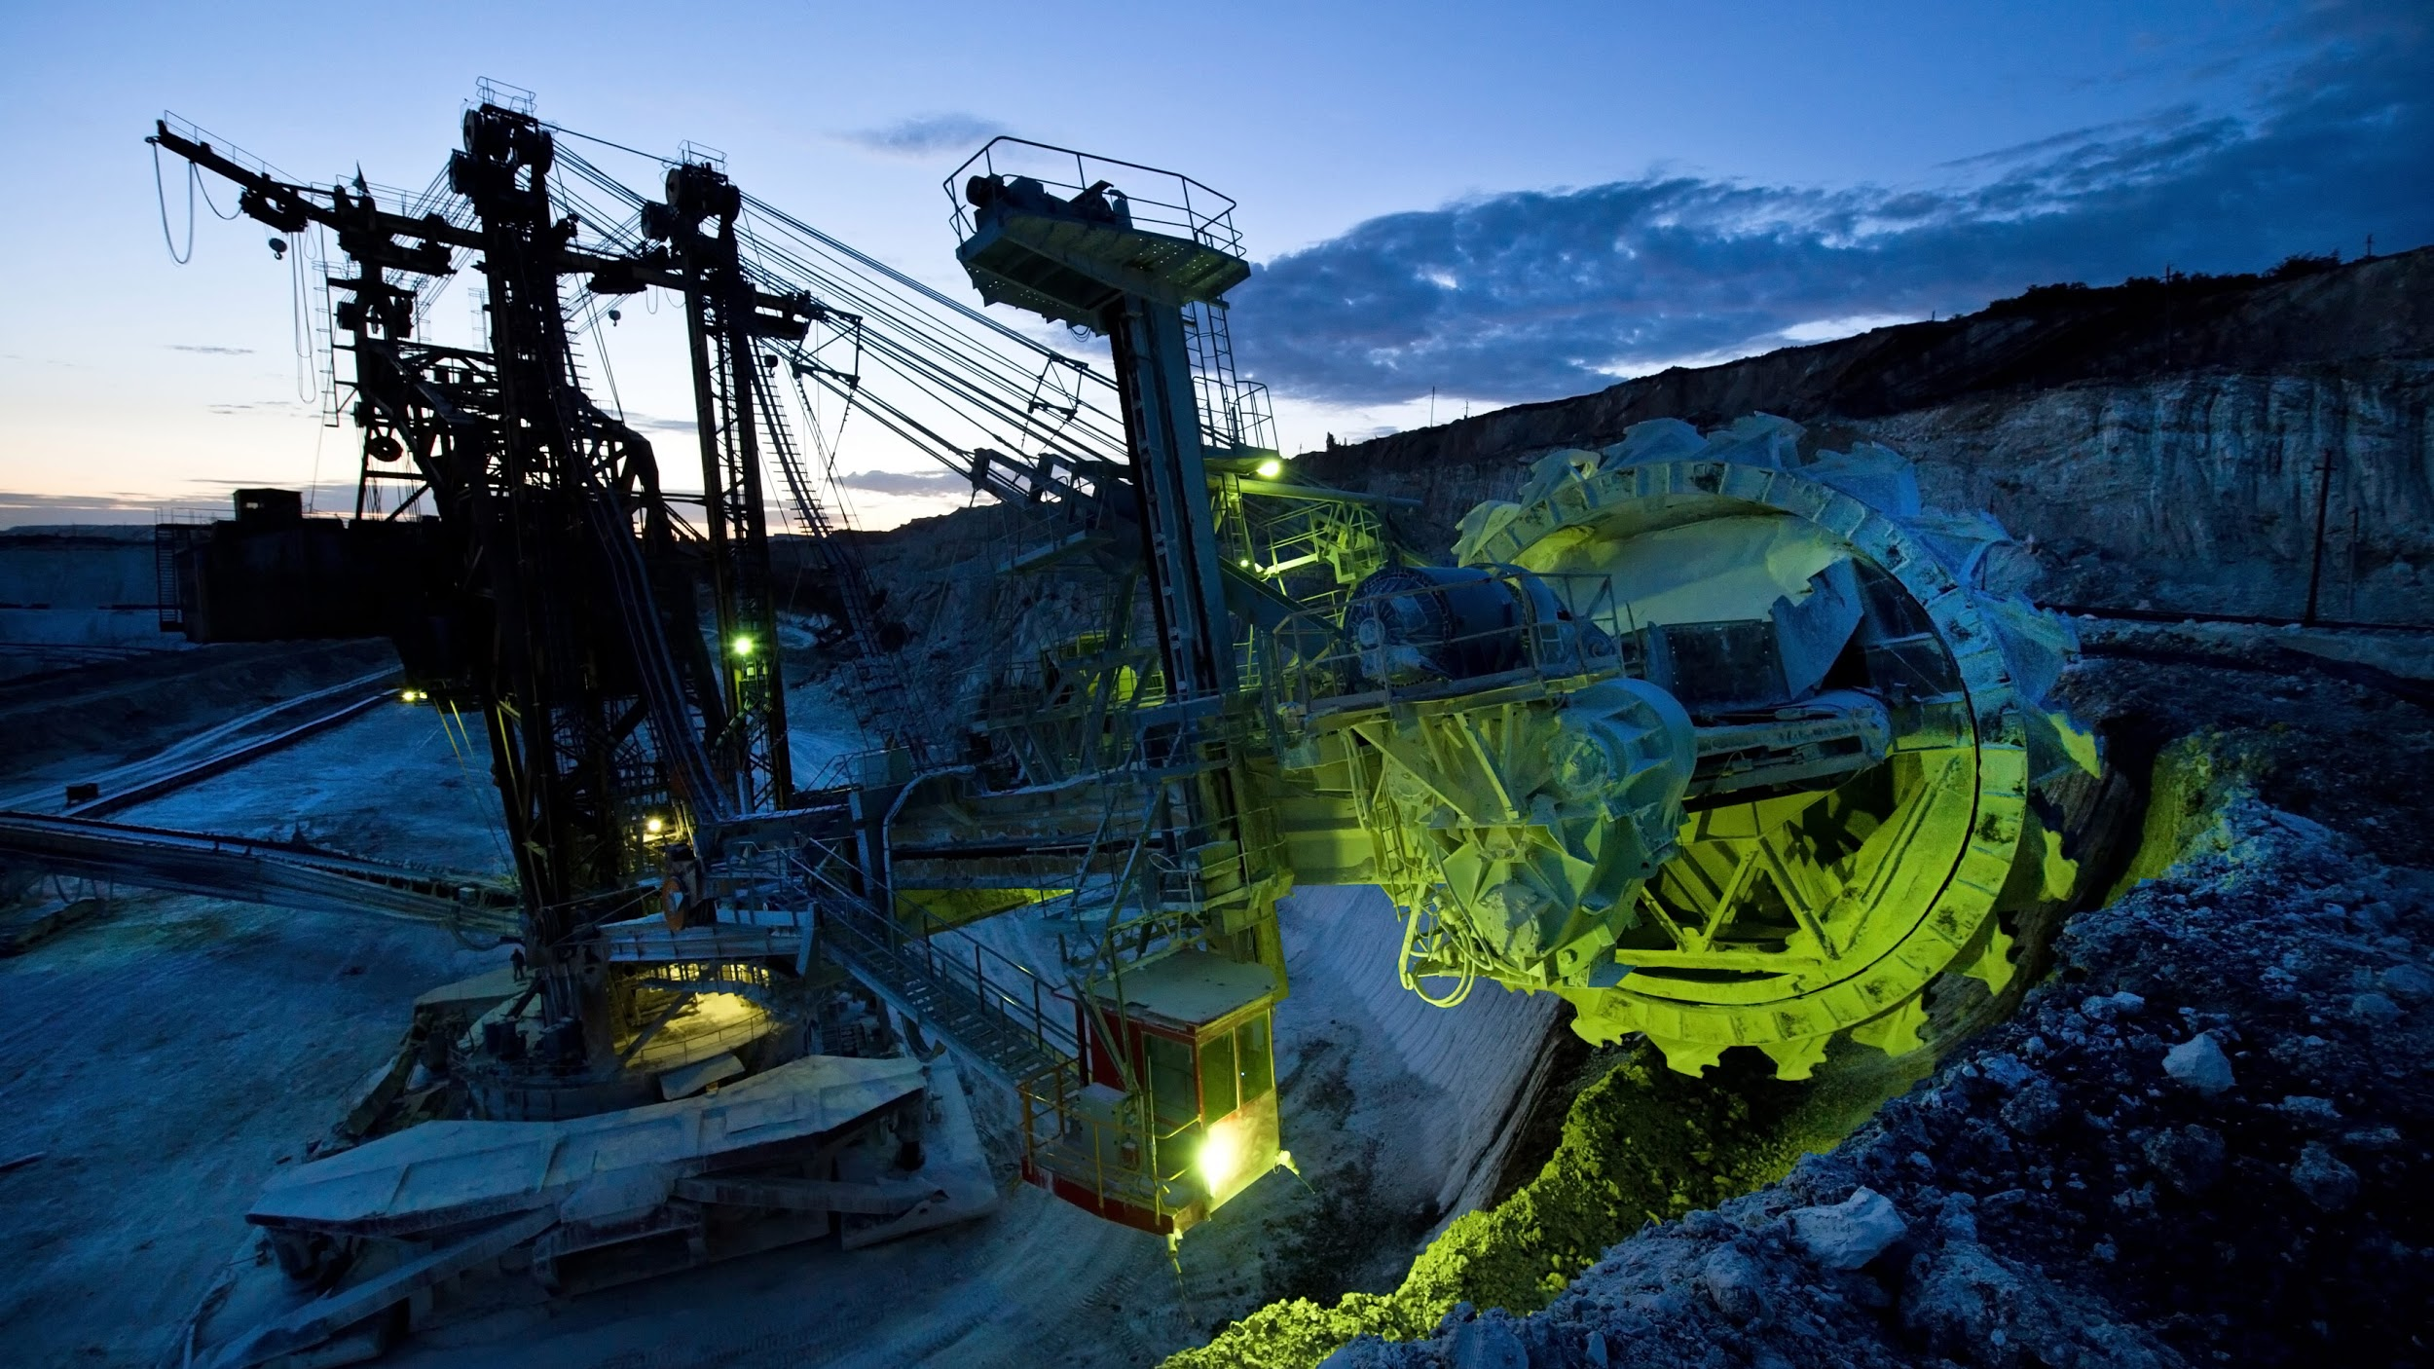
Digital Asset
The inputs we use to train our machine learning model and the inputs to our digital twin are:
Torque (TRQ)
Weight on bit (WOB)
Temperature gradient (TG)
The target variable is the Rate of Penetration.
A number of machine learning models were trained, being:
- Random Forest Regressor
- Support Vector Regressor
- Linear Regression
- ANN Keras Regressor
The best performing model, the Random Forrest Regressor was pickled and deployed in the FlaskApp1.
Notes:
Go into breakout rooms to discuss this

Slide 13
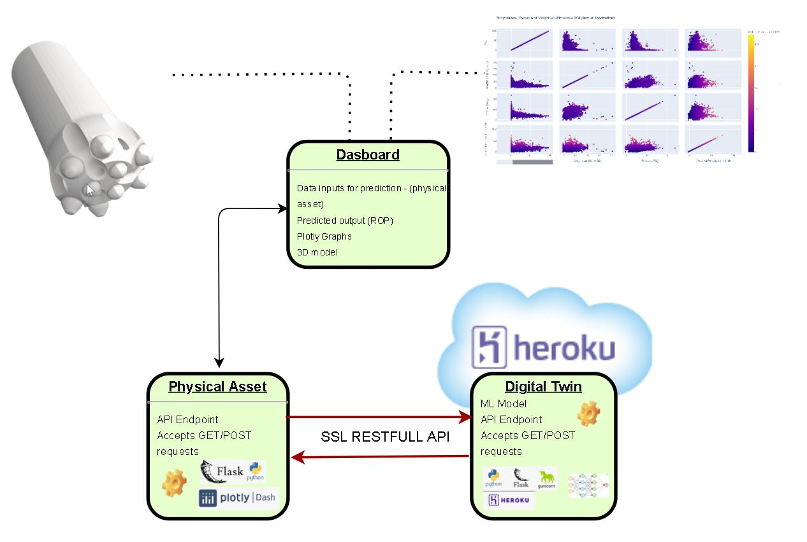
System Architecture
Digital Twin
Hosted in the cloud for scalability, security and accessibility
Inputs are received from the Physical asset
Applies ML model and returns ROP
Physical Asset
Life communication with Digital twin
Accepts inputs via Dashboard or direct API call for continuous data feed
On premises where the action is!
Notes:
Go into breakout rooms to discuss this

Slide 14

Asset Communication
The physical asset sends the following input variables to the digital twin:
Temperature Gradient
Weight on Bit
Torque
The digital twin is located off premises in a Heroku cloud environment
Communication between the Physical asset and Digital twin is securely encrypted using SSL communications
The digital twin exposes a REST API endpoint and accepts GET or POST requests
The digital twin applies a neural network machine learning model to predict the ROP value’s
Results are returned in JSON format
Sample API call:
https://capstonegrpctwin.herokuapp.com/twin?torque=4&temperature=8423&weight_on_bit=48
Notes:
Go into breakout rooms to discuss this

Slide 15
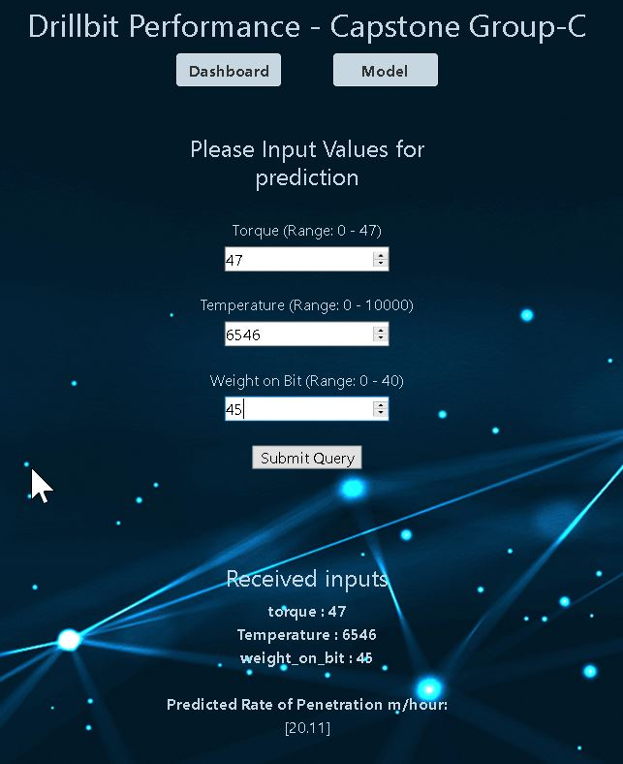
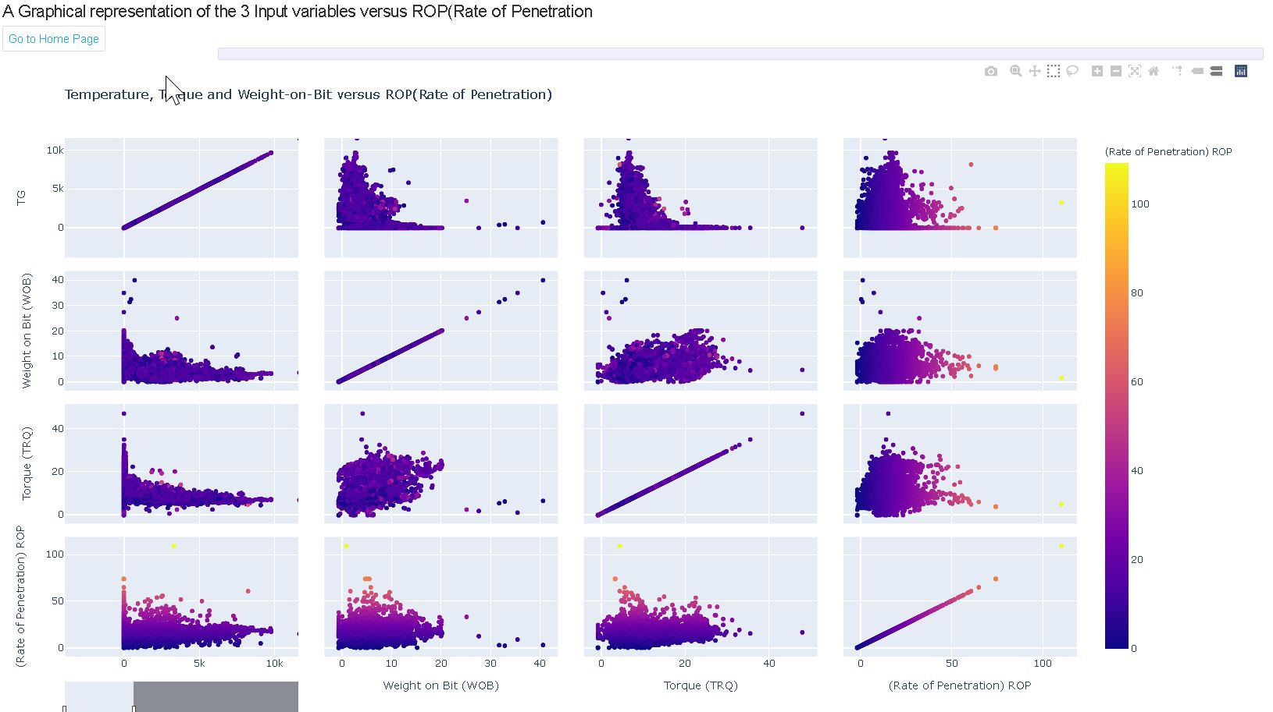
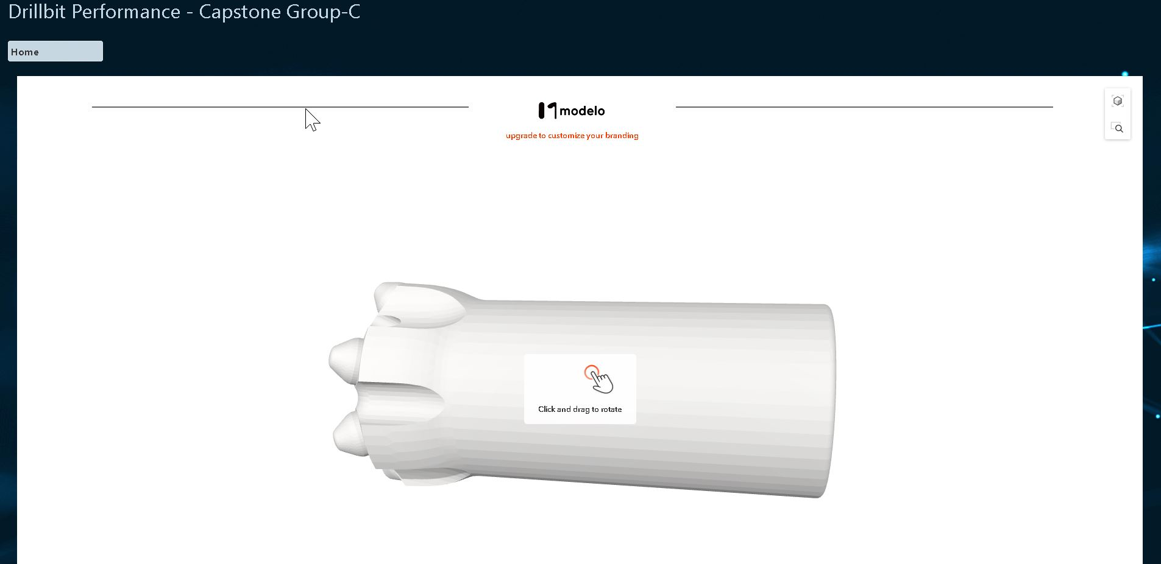
Dashboard
Notes:
Go into breakout rooms to discuss this

Slide 16
Conclusion
Building the digital twin was both challenging and highly engaging throughout the process.
By developing tools which can be used to analyze the button drill bit, we could:
Gain insight to improve operational use to optimize ROP, while reducing bit wear, and thus holistically improving bit life
Easily analyze and interpret the model, and relate the digital results with the physical asset and physical model
Speak to the business case to improve operational efficiency, reduce downtime, and better utilize equipment
Notes:
Go into breakout rooms to discuss this

Slide 17
References
Physical asset -
https://www.kaggle.com/musaabyazan/mu-1x-drilling-data
Rate of prediction -
https://www.intechopen.com/books/drilling/rate-of-penetration-prediction-utilizing-hydromechanical-specific-energy
Drilling pressure comparison - https://www.researchgate.net/publication/327722238_A_Case_Study_Comparison_of_the_Theoretical_and_Actual_Drilling_Hydraulic_Pressures_for_Wells_in_Turkey
Damage Analysis in Rock Rotary Bits - https://www.researchgate.net/publication/312017226_Damage_Analysis_in_Rock_Rotary_Tricones_Bit_-_A_Case_Study
Rate of Penetration -
https://www.sciencedirect.com/topics/engineering/rate-of-penetration
Rate of Penetration -
https://link.springer.com/article/10.1007/s13202-019-0657-2
Notes:
Go into breakout rooms to discuss this

Slide 18
Thank You
Questions?
Notes:
Go into breakout rooms to discuss this

